Slide 1
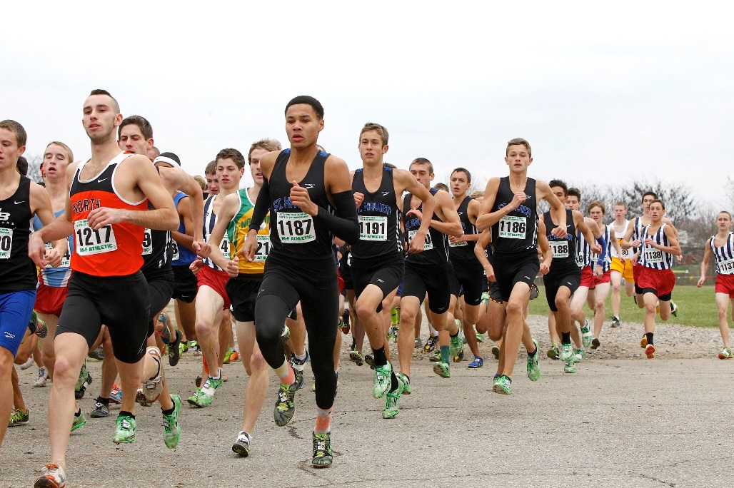
THE OHIO HIGH SCHOOL ATHLETIC ASSOCIATION
Preseason Information for
2017-18 Meetings

Slide 2
Why Interscholastic Athletics & OHSAA Beliefs

Slide 3
• Why Interscholastic Athletics &
OHSAA Beliefs
Participation in interscholastic athletics programs is educational in nature and:
• Complements your school experience.
• Fosters a sense of community and
teaches lifelong lessons of hard work,
teamwork, citizenship and discipline.
• Promotes a lifetime appreciation for
sports and healthy lifestyles.

Slide 4
• Why Interscholastic Athletics &
OHSAA Beliefs
Participation in interscholastic athletics programs:
• Helps prepare you for the next level of
your life as a responsible adult and
productive citizen. Interscholastic
athletics programs are not designed to
prepare you for the next level of
sports.

Slide 5
• Why Interscholastic Athletics &
OHSAA Beliefs
The educational components of participation in interscholastic athletics programs make it unique.
This is unlike many other non-school organizations that promote free player movement, the athletic development of the individual and provide a showcase for those individuals.

Slide 6
• Why Interscholastic Athletics &
OHSAA Beliefs
Participants in interscholastic athletics programs should engage in a well-rounded experience that includes participation in a multitude of extracurricular activities.
In interscholastic athletics:
• Student academic achievement and success
take priority over athletics achievement and
success.
• The success of a team is more important than
individual awards.
Participation in interscholastic athletics programs is a privilege, not a right.

Slide 7
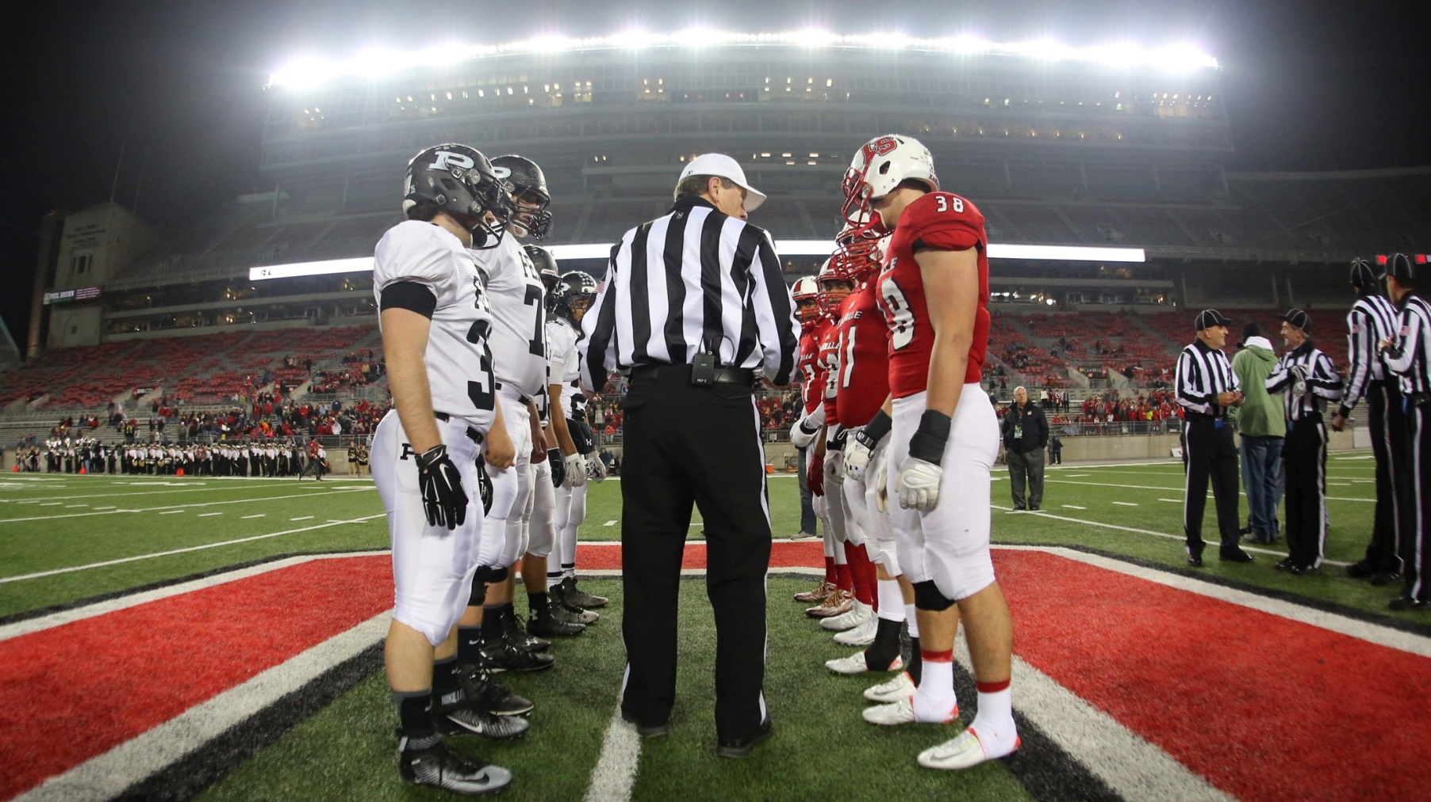
Basic OHSAA Rules & Regulations

Slide 8
• General OHSAA Eligibility Standards
Eligibility rules exist to help maintain competitive balance in school sports and to promote the purpose of education-based athletics.
As a student-athlete, YOU are responsible for your compliance.
Besides OHSAA regulations, your school also has the authority to establish additional academic standards and codes of conduct.

Slide 9
• General OHSAA Eligibility Standards
In order to maintain eligibility, you must be officially enrolled in an OHSAA member school, or participating in accordance with state law, and you must ﻿have a biological and/or adoptive parent who lives in Ohio.
You may not be eligible if you are competing under a false name or have provided your school with an incorrect home address.
You may not be eligible if you have been recruited to attend this school.

Slide 10
• OHSAA Scholarship Standards
All incoming ninth graders must have received passing grades in a minimum of five subjects in the immediately preceding grading period. All grades must be recorded in a student’s academic record.
To maintain eligibility, high school students must have received passing grades in a minimum of five one-credit courses, or the equivalent, in the immediately preceding grading period.

Slide 11
• OHSAA Scholarship Standards
All incoming seventh graders are eligible insofar as the scholarship bylaw regardless of previous academic achievement.
To maintain eligibility, 7th-8th grade students must have received passing grades in a minimum of five classes in the immediately preceding grading period.

Slide 12
OHSAA Scholarship Standards
Students taking College Credit Plus must comply with OHSAA scholarship standards.
All students participating via state law that permits home educated, non-public, community and STEM school students to participate at public schools must also comply with OHSAA scholarship standards.
Semester and yearly grades have no effect on OHSAA eligibility unless your school provides grades at the end of a semester or school year pursuant to Board of Education policy.

Slide 13
• OHSAA Scholarship Standards
To attempt to regain OHSAA eligibility, summer school grades, including College Credit Plus courses, may NOT be used to substitute for failing grades received in the final grading period of the regular school year or for lack of enough courses taken the preceding or subsequent grading period.
If you drop a course or change your schedule, it is critically important that you contact your principal or athletic administrator to see if this affects your eligibility.
The OHSAA has no minimum grade point (GPA) requirement, thus issues regarding eligibility when only the state-mandated GPA is of concern are strictly a local school district matter and not an OHSAA matter.

Slide 14
• OHSAA Semester Standards
No high school student will be eligible if he or she has been enrolled in high school for more than eight semesters.
No 7th-8th grade student will be eligible if he or she has been enrolled in 7th-8th grade for more than four semesters.

Slide 15
• OHSAA Age Standards
High school students will be ineligible whenever they turn 20 years old.
Seventh- and eighth-grade students who turn 15 before August 1st are also ineligible for 7th and 8th grade sports but MAY BE eligible to participate in high school athletics.

Slide 16
• OHSAA Non-School Team and Program &
Out-of-Season Standards
You will be ineligible if you are a member of a school team competing on a non-school team in the same sport during your school team’s season (example: club soccer team during school’s soccer season).
Coaches and schools cannot require that you participate in an open gym/open facility OR in a conditioning or instructional program. Violations of this regulation will result in penalties.

Slide 17
• OHSAA Non-School Team and Program &
Out-of-Season Standards
There are certain restrictions regarding tryouts, practices and competitions with non-school teams before, during and after the school season.
There are also restrictions for instruction you can receive from school coaches outside of your season in an OHSAA team sport (baseball, basketball, field hockey, football, ice hockey, lacrosse, soccer, softball and volleyball) and some OHSAA individual sports (cross country, track & field and wrestling).
There are no restrictions for instruction you can receive from school coaches outside of your season in many OHSAA individual sports (bowling, golf, gymnastics, swimming & diving and tennis).

Slide 18
• OHSAA Amateur Standards
You could lose your amateur status and forfeit your eligibility if you compete for money or other monetary compensation OR capitalize on your athletic fame by receiving money, merchandise or services or by entering into an agreement with a professional team or agent.

Slide 19
• OHSAA Transfer Standards
Once eligibility has been established at a member high school and you transfer to another school, you will be ineligible for all contests until the first 50 percent of the maximum allowable regular season contests have been competed in any sport in which you participated during the 12 months immediately preceding your transfer.
This regulation has several exceptions, most of which require a ruling from the OHSAA Commissioner’s Office.

Slide 20
• OHSAA Transfer Standards
Should you have transferred to this school, you must ensure all required paperwork has been submitted to the OHSAA AND the state office has granted approval for eligibility.
Immediate eligibility will be granted only if one of the exceptions to the OHSAA transfer regulation has been met.

Slide 21
• General OHSAA Eligibility Standards
There ARE exceptions to some OHSAA regulations. If you believe you qualify for an exception or you have questions pertaining to your eligibility or about any of the regulations, please consult with your school principal or athletic administrator.
Ask your school principal or athletic administrator to discuss any unresolved issues with the administrators in the OHSAA office who handle eligibility issues.
You can also review all OHSAA regulations on eligibility standards by going to the OHSAA website at www.ohsaa.org.

Slide 22
Your Health & Safety

Slide 23
• Your Health & Safety
Before the season’s first practice (or prior to your first participation should you join the team after the season has started), you must have had a physical examination within the past year AND an examination clearance form must be on file at the school.
You and your parents are highly encouraged to work with your certified athletic trainer and/or athletic administrator to complete an electronic preparticipation evaluation form that was developed for the OHSAA by PrivIT and called the PrivIT Profile™. This Profile is now the OHSAA standard.
(http://privit.com/privit-products/privit-profile/)

Slide 24
• Your Health & Safety
In addition, you will not be eligible unless you and your parents have signed the OHSAA Authorization Form, the OHSAA Eligibility & Authorization Statement and the Ohio Department of Health’s (ODH) concussion form and ODH’s new sudden cardiac arrest form*, all of which must be on file at your school. These forms can be e-signed within the PrivIT Profile™.
* Note: As of May 8, the sudden cardiac arrest information
sheet/form was not completed. OHSAA member schools will be informed as soon as all materials are finalized and available.

Slide 25
• Concussions
It is EXTREMELY important for everyone involved in school sports to recognize the potential dangers associated with concussions and review their responsibilities in protecting student-athletes.
Concussions are NOT just a problem in football . . . concussions can happen in just about any sport!
A concussion is a traumatic brain injury that interferes with normal function of the brain. “Dings” and “bell ringers” are SERIOUS brain injuries and you do NOT have to have loss of consciousness for it to be considered serious. Young athletes are at increased risk for serious problems.

Slide 26
• Concussions
In Ohio, any athlete who exhibits signs, symptoms, or behaviors consistent with a concussion . . . such as loss of consciousness, headache, dizziness, confusion or balance problems . . . shall be IMMEDIATELY removed from the contest or practice and shall not return to play that same day.
Thereafter, the student shall not return to practice or competition until cleared with WRITTEN AUTHORIZATION from a physician or health care provider approved by the local board in accordance with state law.

Slide 27
• Concussions
Each school is required to review its concussion management protocol with you and your parents.
In addition, you and your parents must review and sign the Ohio Department of Health’s “Concussion Information Sheet” prior to participation, and you are highly encouraged to review a short presentation on concussions available at no cost (www.nfhslearn.com).

Slide 28
• Concussions
While return-to-play policies are very important, parents must also work with school administrators and teachers in developing concussion management guidelines for student-athletes who have been concussed and are returning to the classroom (i.e. Return to Learn).

Slide 29
• Sudden Cardiac Arrest
You and your parents are required to view the Ohio Department of Health’s sudden cardiac arrest video* that may be shown at your school.
In addition, you and your parents must review and sign the Ohio Department of Health’s “Sudden Cardiac Arrest Information Sheet”* prior to participation.
* Note: As of May 8, the Sudden Cardiac Arrest video and
information sheet were not completed. OHSAA member schools
will be informed as soon as all materials are finalized and
available.

Slide 30
• Additional Health & Safety Guidelines
The OHSAA does not permit the use of any form of alcohol, tobacco or illegal drugs.
Besides the health risks involved, use of any of these items will result in students being disqualified from contests and violators likely facing additional school and legal penalties.

Slide 31
• Additional Health & Safety Guidelines
Another prominent issue is the use of performance enhancing supplements.
The increased availability of these items allows students easy access to a wide variety of products aggressively marketed to include promises — endorsed by faulty research claims — of extraordinary weight loss, explosive power or tremendous strength gains.
It is important for parents to educate themselves about what substances their child may be using and about the potential risks involved with uneducated supplement use.

Slide 32
• Additional Health & Safety Guidelines
Beyond performance enhancing supplements, there are additional issues related to illicit drugs, such as anabolic steroids and some prescription drugs used with the goal of aiding performance.
Use of these drugs will result in disqualification from all interscholastic athletics.
The OHSAA website (www.OHSAA.org) provides a wealth of information to assist parents, coaches, students and anyone interested in learning more about sports medicine and healthy lifestyles.

Slide 33
Sporting Behavior

Slide 34
• Respect The Game
The OHSAA’s vision for positive sporting behavior is built on expectations. It calls on the school community — administrators, contest officials, coaches, students, parents and fans — to strive for positive sporting behavior in everything they do by teaching the values of ethics, integrity, equity, fairness and respect.
As a student-athlete, you must always remember to Respect The Game!

Slide 35
• Respect The Game
That means you are expected to accept the responsibility and privilege of representing your school and community while participating in school sports. You are expected to:
• Treat opponents, coaches and officials with
respect.
• Ensure that your actions do not incite fans or
other participants or attempt to embarrass,
ridicule or demean others.

Slide 36
More on the OHSAA

Slide 37
• Organization Helping Student-Athletes
Achieve
Like the other 820 public and non-public high schools and approximately 800 7th and 8th grade schools, your school has volunteered to become a member of the Ohio High School Athletic Association.
Ohio is one of the top ranked states in the country with over 350,000 high school students competing in 26 sanctioned sports.

Slide 38
• Organization Helping Student-Athletes
Achieve
For many of you, playing on your school teams may be the last time you will participate in competitive athletics.
The OHSAA wants to make sure your time as a high school student-athlete is meaningful and memorable.

Slide 39
• Organization Helping Student-Athletes
Achieve
Key OHSAA initiatives:
• Establishing and regulating regular season
and tournament standards in order for
competition to be fair and equitable.
• Administering exceptional post-season
tournaments.

Slide 40
• Organization Helping Student-Athletes
Achieve
Other key OHSAA initiatives:
• Providing annual scholarships totaling over
$100,000 to students who excel in athletics and
academics.
• Licensing, registering and training nearly 17,000
contest officials.
• Ensuring coaches are certified to work with
student-athletes through an ongoing coach
education program.

Slide 41
• Organization Helping Student-Athletes
Achieve
The OHSAA has had a tradition of excellence for over 100 years, with our ultimate purpose to promote lifetime values, good citizenship, academic success, ethics and fair play in safe and sporting environments.
For more information and additional resources, visit the OHSAA website (www.OHSAA.org) and follow us on Twitter (twitter.com/OHSAASports) and Facebook (facebook.com/OHSAA).
Have a great season!

